Slide 1

How to Get More Sleep
and Require Less Coffee

Slide 2

State of Ops

Slide 3
Why We Sleep on the Couch
We’re the ones they call when
“The website is down”
The customer is having an “weird” issue
A critical exploit just entered the wild
“I can’t login to the domain”
New deployment off hours
Offshore needs 6 new VMs for testing
“I’m doing a customer demo at 8AM”
Notes:
Say we can put these fires out long enough to get ourselves into the next work day

Slide 4
Guys What R U Doin
Building VM templates
ISO install and configuration
Network setup
Set up users/group, security, authentication/authorization
Software install and configuration
Building out clusters
Cloning N number of VMs from X number of templates
Hostname/network configuration
Firewalling
Software deployments
Turn off monitoring/alerting
Pull nodes out of Load Balanced Group
Run DB migrations
Deploy application code
Restart web server
Put nodes back in/turn monitoring back on
Server maintenance
SSH in to every server and restart a service
Write complex scripts to log in to every server and update openssl
Notes:
Before configuration management. The operations team get a request to bring up a web server on new ubuntu machibe. You ssh to the machine, install the required packages , editing the configuration files manually and finally copying application code. Think of doing this on ay 10 , may be 100 machines. More problems arise when a machine dies and when trying to recreate it. How was this set up done, I followed the steps I did previously … why is showing this error…..?

Slide 5
Put an M on It
Configuration Management (CM)
authoritative centralization of configuration data and actions
history of updates, changes for auditing purposes
define the exact state a system should be in
Infrastructure CM
define the state that a system should be in with respect to it’s configuration and use tools that achieve that state
enforce consistency across an entire environment
automate to increase efficiency and repeatability
easier to affect change (cloud provider, OS, etc.)
remove the human factor
disaster recovery
Notes:
You’ve heard of SCM, change management, release management, patch management…
Configuration management

Slide 6
Server Management
configuration management,:
refers to writing some kind of state description for our servers, and then using a tool to enforce that the servers are,indeed, in that state.
the right packages are installed,
configuration files contain the expected values
Cofig files have the expected permissions,
the right services are running,and so on.
Deployment :
It refers to the process of taking software that was written in-house, generating binaries or static assets (if necessary), copying the required files to the server(s), and then starting up the services. Capistrano and Fabric are two examples of open-source deployment tools.

Slide 7
Infrastructure management -more
Orchestration of deployment : This is where multiple
remote servers are involved, and things have to happen in a specific order.
Scenarios could be
bring up the database before bringing up the web servers,
take web servers out of the load balancer one at a time in order to upgrade them without downtime.

Slide 8
Infrastructure management – some more
Provisioning : In the context of public
Clouds this refers to spinning up a new virtual machine
instance.
There are tools that bring up servers on
clouds, including EC2, Azure, Digital Ocean, Google Compute Engine, Linode, and Rackspace, as well as any clouds that support the OpenStack APIs.
Notes:
Ansible can be used in all these areas of infrastructure management.

Slide 9
Tool Time
Puppet
great with Windows (as long as they’re not XP)
amazing Enterprise support
cryptic DSL
Chef
easy to learn if you’re a ruby developer!
amazing wealth of cookbooks
Almost too verbose
SaltStack

Slide 10
Ansible
Agentless!
Uses SSH (with one python requirement)
Everything is a YAML file
Structure is flexible (ad-hoc, playbooks, roles, orchestration)
Easily extensible via modules
Encryption and security built in
Full power at the CLI (open source!)
Even more features available in enterprise (Tower)
Idempotent

Slide 11
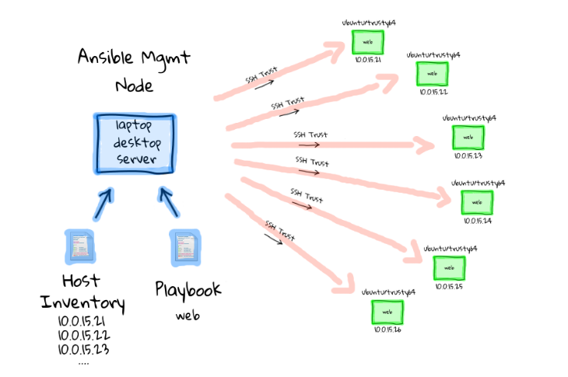
As simple as it gets

Slide 12
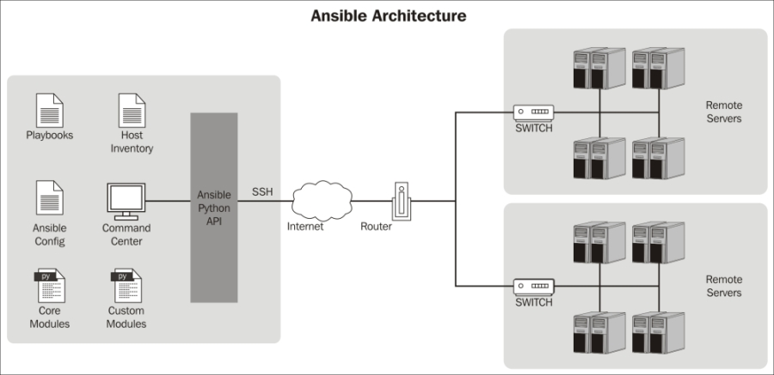

Slide 13
Why the name - ansible?
It’s a science fiction reference. An ansible is a fictional communication device that can transfer information faster than the speed of light.
In a sci-fi book, the ansible was used to control a large number of remote ships at once, over vast distances.
Think of it as a metaphor for controlling
remote servers.

Slide 14
Idempodent: Example
• You need all your application servers’ tomcat setenv.sh to look like:
JAVA_HOME=/usr/java/latest
JAVA_OPTS=\"-Xms512m -Xmx1024m -XX:PermSize=128m -XX:MaxPermSize=256m\"
CATALINA_HOME=/usr/local/tomcat
• You could get the job done with a classic echo command
echo JAVA_HOME=/usr/java/latest >> /usr/local/tomcat/bin/setenv.sh
echo JAVA_OPTS=\"-Xms512m -Xmx1024m -XX:PermSize=128m -XX:MaxPermSize=256m\"
>> /usr/local/tomcat/bin/setenv.sh
echo CATALINA_HOME=/usr/local/tomcat >> /usr/local/tomcat/bin/setenv.sh
• But…
what if these lines already exist?
what if the file doesn’t exist on a few of the servers?
what if you needed to run your script again to update/restore another setting?
If you don’t know the beginning state of the system, the end state is unpredictable
Notes:
. But with ansible you
Describe the end state you want. It will get you to that state regardless of starting point.

Slide 15
Ansible - Idempotent
You could write complex shell script to manage the above scenarios .
Ansible is much more powerful and safe than something like a typical shell script. It is challenging enough to write a shell script that can configure a system (or lots of systems) to a specific state. It is extremely challenging to write one that can be run repeatedly against the same systems and not break things or have unintended side effects. Ansible being idempotent , can safely be run against the same systems again and again without failing or making any changes that it does not need to make.

Slide 16
Ansible terms
Inventory Modules Ad Hoc Commands
Playbooks
Tasks Variables Templates Handlers Roles Facts Vaults
Ansible Tower Ansible Galaxy
By the way Ansible is a Python application

Slide 17
Inventory:
Ansible uses an inventory file to determine what hosts to work against. In its simplest form, an inventory file is just a text file containing a list of host names or IP addresses - one on each line
[webservers]
foo.example.com http_port=80
bar.example.com http_port=8080
[dbservers]
db[01:03].example.com
[dbservers:vars]
pgsql_bind_nic=eth1
[proxies]
192.168.1.1

Slide 18
modules
Ansible uses "modules" to accomplish most of its Tasks. Modules can do things like install software, copy files, use templates and much more.
seek to avoid changes to the system unless a change needs to be made
Simple examples : shell, apt
ansible comes preloaded with a plethora of modules

Slide 19
Modules provided by Ansible
users
groups
packages
ACLs
files
apache modules
firewall rules
ruby gems
git repositories
mysql and postgresql databases
docker images
AWS / Rackspace / Digital Ocean instances
Campfire or Slack notifications
Lots more …..
Notes:
You can create create your own custom module.

Slide 20
Ad Hoc Commands
run a single, one-off command
run on a full or partial inventory
run on a single host
no need to save for later
$ ansible webservers –m command –a “dpkg-query –W openssl” –u joe –k
SSH password:
foo.example.com | success | rc=0 >>
openssl 1.0.1e-2+deb7u10
bar.example.com | success | rc=0 >>
openssl 1.0.1e-2+deb7u10

Slide 21
Playbooks
More powerful configuration management
Kept in source control, developed, validated
Declare configurations of more complex mutli-system enviornments
Arrange and run tasks synchronously or asynchronously

Slide 22
Tasks
Think of a Task as a single Bash command.
Notes:
structure

Slide 23
Variables:
Variables in Ansible are how we deal with differences between systems.
Yml file describing variables
foo:
field1: one
field2: two
You can then reference a specific field in the dictionary using either bracket notation or dot notation
foo['field1']
foo.field1

Slide 24
Templates
Makes the configuration files dynamic
It is written in jinja2
The difference between a Template and a File is a small but important one. Ansible will copy a file to your server exactly as it appears in your Playbook. A Template, on the other hand, can contain variables that Ansible will substitute with real values before copying across to the server.

Slide 25
Handlers
Written just like a regular task
Only run if triggered by the notify directive
Indicates a change in the system state
Any module can be used for the handler action
Handler
- name: Restart Tomcat
service: name=tomcat state=restarted
Task
- name: Apache Tomcat | Configure | Overlay configuration
template: src=‘{{item.file}}' dest='{{item.target}}’
with_items: tomcat.config_files
notify: Restart Tomcat

Slide 26
Roles
Break up configuration into repeatable chunks
Reduce, reuse, recycle
Clean, understandable structure
Stack on top of each other
similar to chef cookbooks

Slide 27
Orchestration
“Rolling Updates”
Performing very complex infrastructure or cluster operations
Run plays in serial instead of parallel
Wait for certain conditions to move forward
Abort if certain percentage of failure

Slide 28
Orchestration: Example
turn off monitoring and alerting
remove application server from load balanced group
stop services
wait for services to stop fully
checkout new code from git
deploy webapp
restart services
wait for services to start fully
return to load blanced group

Slide 29
Example: Server provisioner
Build and configure webserver
---
#packer provisioning only
- hosts: all
connection: local
remote_user: vagrant
sudo: True
sudo_user: root
vars_files:
- roles/vars/cloud.encrypt
vars:
lifecycle: 'production'
build_flavor: 'cloud'
app_flavor: 'app'
roles:
- roles/debian
- roles/vmware-tools
- roles/local-users
- roles/active-directory
- roles/cloud-baseline
- roles/sudoers
- roles/iptables
- roles/java-jdk-7
- roles/tomcat-7
- { role: roles/tomcat-native, when: native == 'true' }
- roles/ansible
- roles/app-dynamics
- roles/opsview
- roles/cleanup
- roles/git
tasks:
- name: Reboot the Server
command: '/sbin/reboot'
- name: Wait for Server to come back
wait_for: host='{{inventory_hostname}}' port='22’
sudo: no
delegate_to: localhost
- name: Wait for Services to start fully
wait_for: port='{{item}}' delay='5' timeout='600'
with_items:
- '8009' #ajp
- '8080' #tomcat
Notes:
Full server build with roles

Slide 30
Where do I go from here?
Stop doing everything by hand!
If you find yourself logging in to more than one VM to do the same task...
If you have been meaning to get around to patching or updating a bunch of VMs...
If you know all of the prompts of the OS installer by heart...
If scp and vi are your favorite tools...
If you dread the next release of your application
If you wince every time your phone rings

Slide 31

Use Ansible
Get more sleep
Require less coffee

Slide 32
Yaml - basic overview
For Ansible, nearly every YAML file starts with a list. Each item in the list is a list of key/value pairs, commonly called a “hash” or a “dictionary”. So, we need to know how to write lists and dictionaries in YAML.
All YAML files can optionally begin with --- and end with .... This is part of the YAML format and indicates the start and end of a document.
All members of a list are lines beginning at the same indentation level starting with a "- " (a dash and a space)

Slide 33
Yml describing list of fruits
---
# A list of tasty fruits
fruits:
- Apple
- Orange
- Strawberry
- Mango
...

Slide 34
Dictionary in YML
A dictionary is represented in a simple key: value form
# An employee record
martin:
name: Martin D'vloper
job: Developer
skill: Elite
Notes:
(the colon must be followed by a space)

Slide 35
More …
More complicated data structures are possible, such as lists of dictionaries, dictionaries whose values are lists or a mix of both.
# Employee records
- martin:
name: Martin D'vloper
job: Developer
skills:
- python
- perl
- pascal
- tabitha:
name: Tabitha Bitumen
job: Developer
skills:
- lisp
- fortran
- erlang

Slide 36
…
---
martin: {name: Martin D'vloper, job: Developer, skill: Elite}
fruits: ['Apple', 'Orange', 'Strawberry', 'Mango‘]
Dictionaries and lists can also be represented in an abbreviated form.
you can also specify a boolean value (true/false) in several forms:
create_key: yes
needs_agent: no
knows_oop: True
likes_emacs: TRUE
uses_cvs: false

Slide 37
…
Values can span multiple lines using | or >. Spanning multiple lines using a | will include the newlines. Using a > will ignore newlines; it’s used to make what would otherwise be a very long line easier to read and edit. In either case the indentation will be ignored. Examples are:
include_newlines: |
exactly as you see
will appear these three
lines of poetry
ignore_newlines: >
this is really a
single line of text
despite appearances

Slide 38
Combine what we learned
---
# An employee record
name: Martin D'vloper
job: Developer
skill: Elite
employed: True
foods:
- Apple
- Orange
- Strawberry
- Mango
languages:
perl: Elite
python: Elite
pascal: Lame
education: |
4 GCSEs
3 A-Levels
BSc in the Internet of Things

Slide 39
Environment for practice
Virtual box
AWS ec2 with either ubuntu
Essentially we need to simulate multiple hosts.

Slide 40
Ansible - install
http://docs.ansible.com/ansible/intro_installation.html
For ubuntu:
apt-get -y install software-properties-commonapt-add-repository -y ppa:ansible/ansibleapt-get updateapt-get -y install ansible
For Centos
sudo yum install epel-release
sudo yum install ansible

Slide 41
key-based authentication
Ansible will assume you have SSH access available to your servers, usually based on SSH-Key. Because Ansible uses SSH, the server it's on needs to be able to SSH into the inventory servers. It will attempt to connect as the current user it is being run as. If I'm running Ansible as user vagrant, it will attempt to connect as user vagrant on the other servers.

